Slide 1
Indium vs Uranium calibration before and after the water moderator change
MK June 2015
MK February 2016

Slide 2
t0 values comparison

Slide 4
LO values comparison

Slide 7
L1 Survey offest

Slide 8
theta survey offset

Slide 9
E1 IPSurvey offset

Slide 10
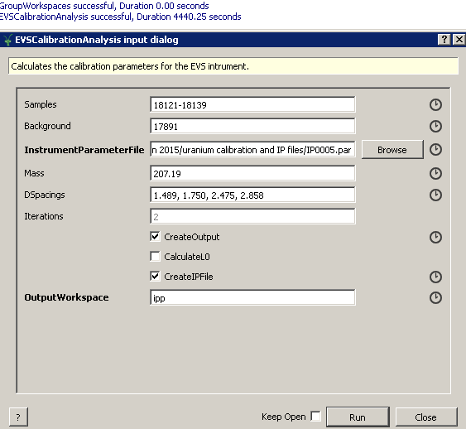
Indium-based calibration
28/02/2016 with data before moderator change

Slide 11
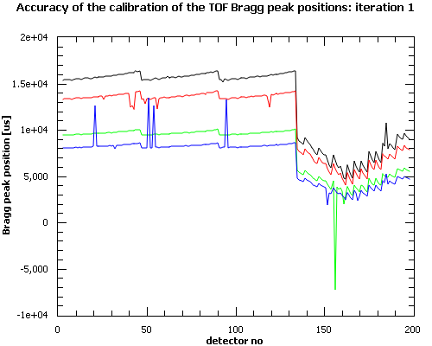
Angular calibration based on positions of 4 lead Bragg peaks:
Accuracy of the calibration of the Bragg peak positions based on d-spacings
only and no PeakFinder

Slide 12
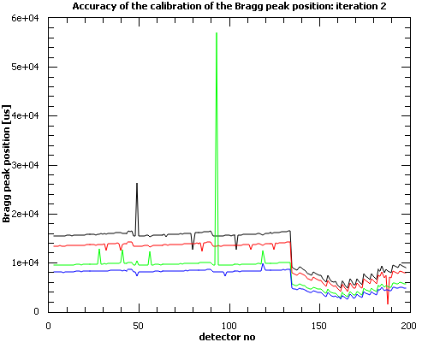
Angular calibration based on positions of 4 lead Bragg peaks:
Accuracy of the calibration of the Bragg peak positions based on d-spacings
only and no PeakFinder

Slide 13
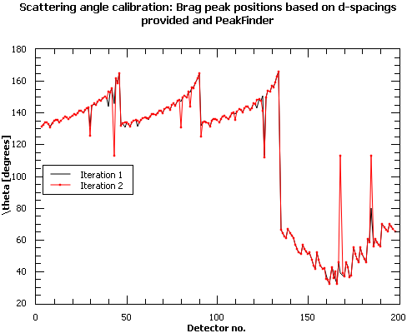

Slide 14
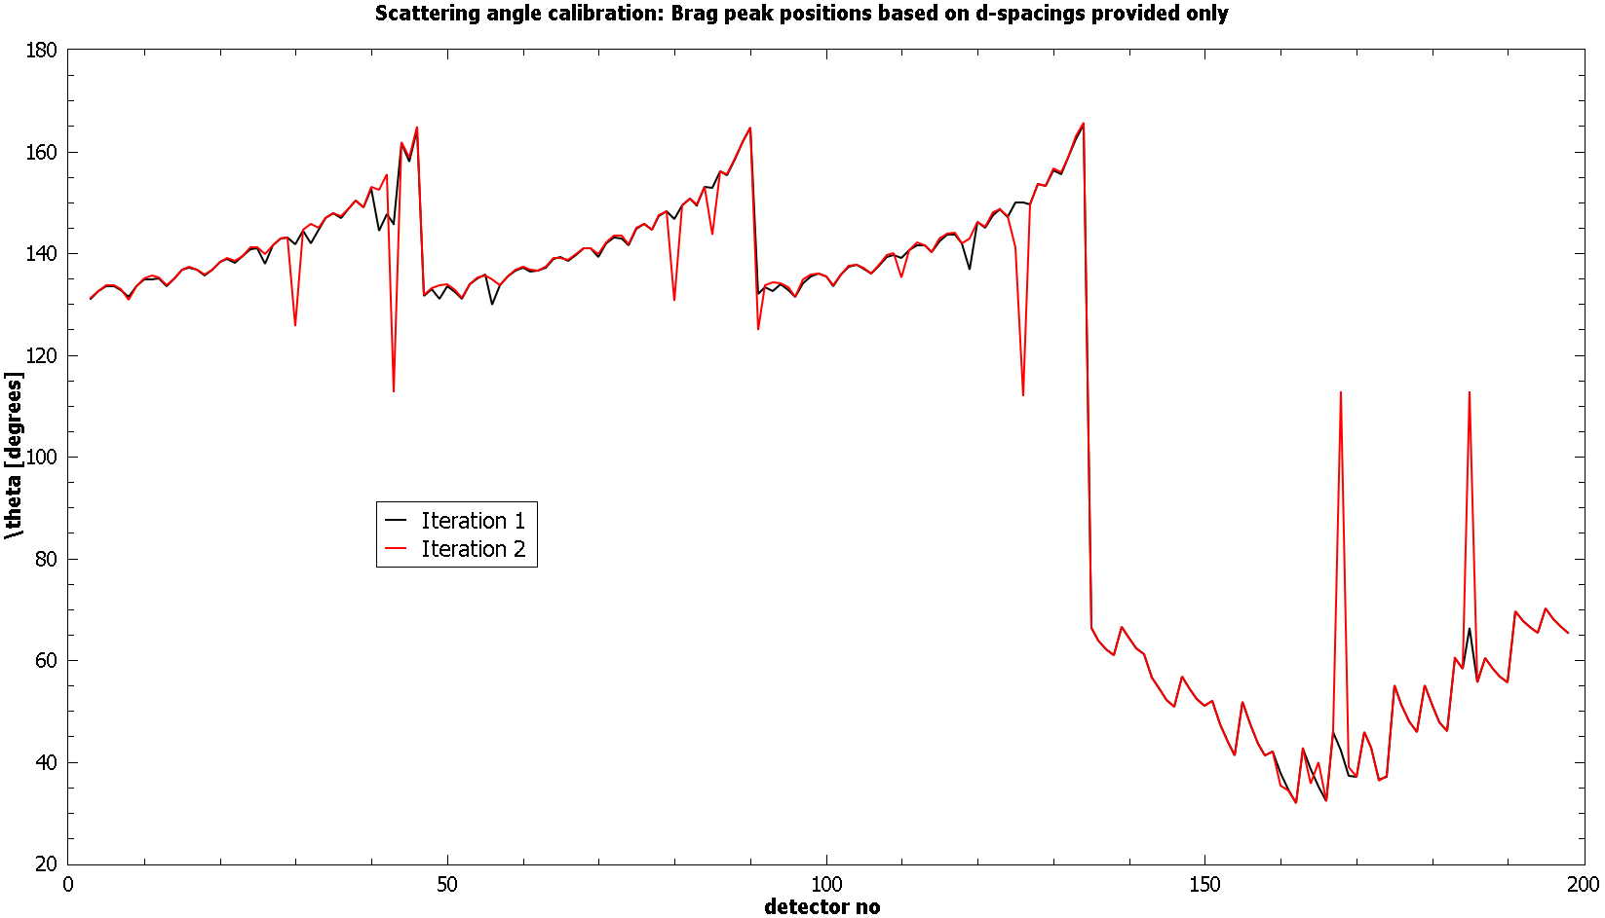

Slide 15
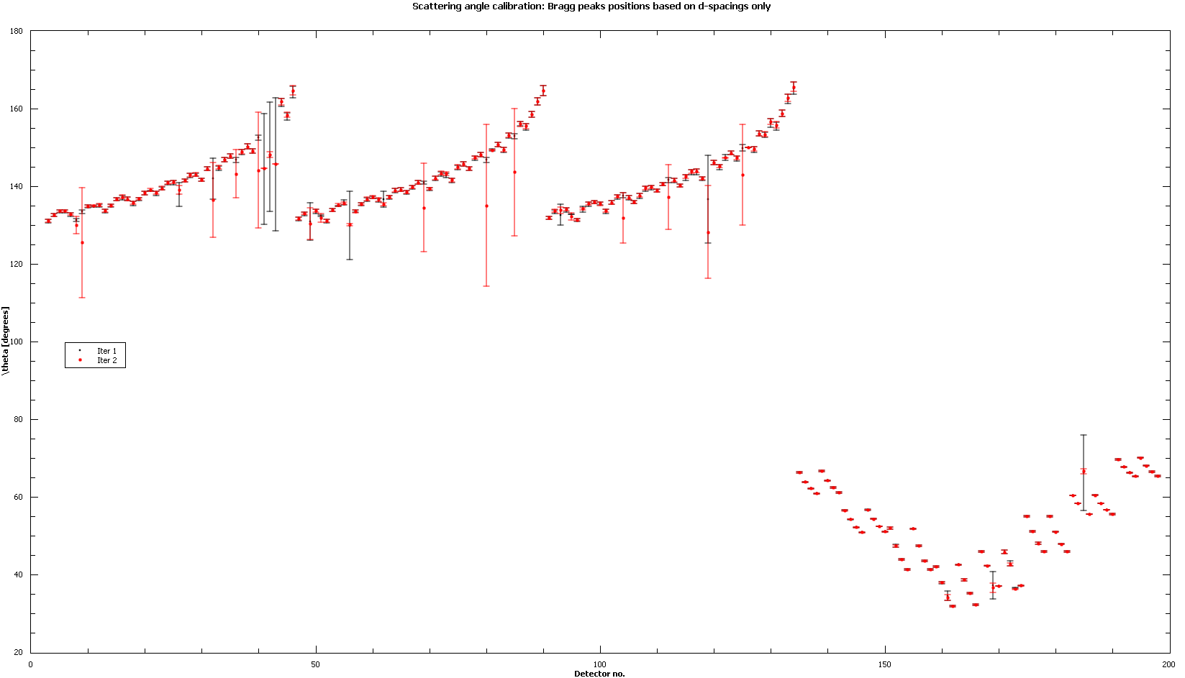

Slide 16
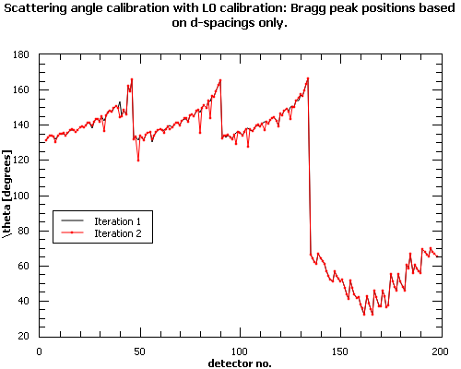

Slide 17
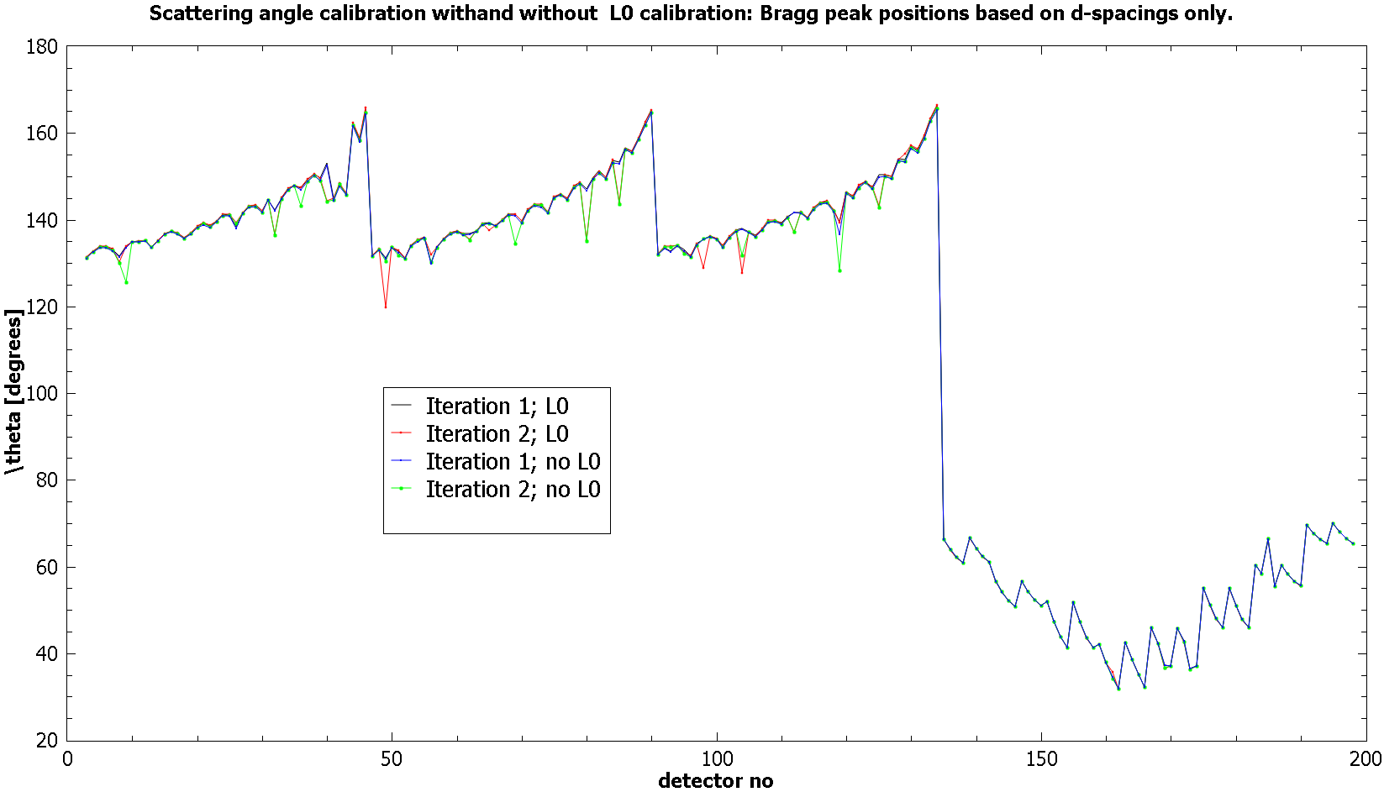

Slide 18
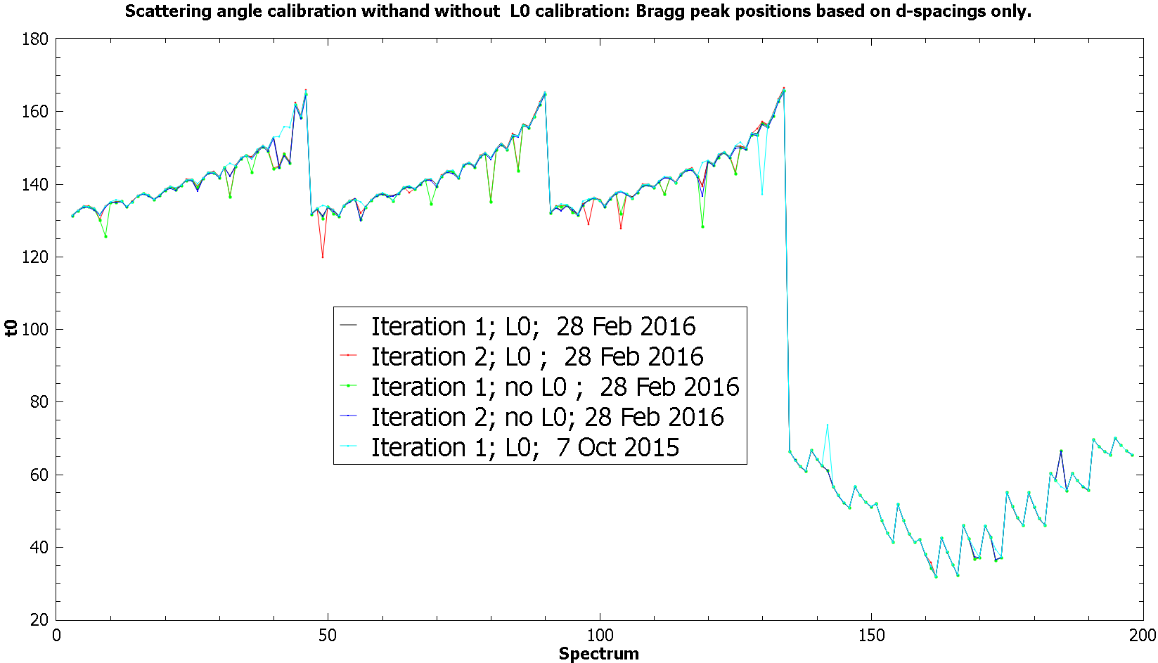

Slide 19
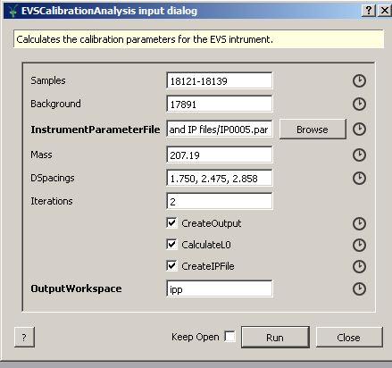
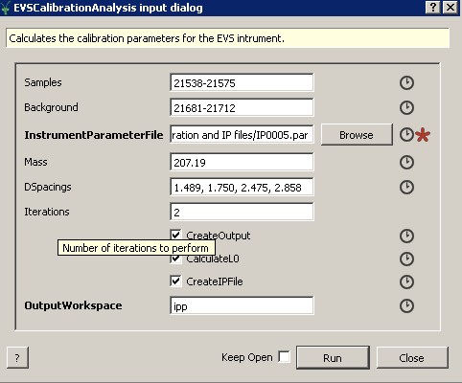
Comparison of the uranium-based VESUVIO calibration
before and after the water Moderator change:
Before moderator change: After moderator change:
With DSpacings(1) = 1.489
Without DSpacings(1)
With DSpacings(1) = 1.489
Without DSpacings(1)

Slide 25
Comparison of the indium-based VESUVIO calibration
before and after the water Moderator change:
Before moderator change: After moderator change:
With DSpacings(1) = 1.489
Without DSpacings(1)
With DSpacings(1) = 1.489
Without DSpacings(1)

Slide 31
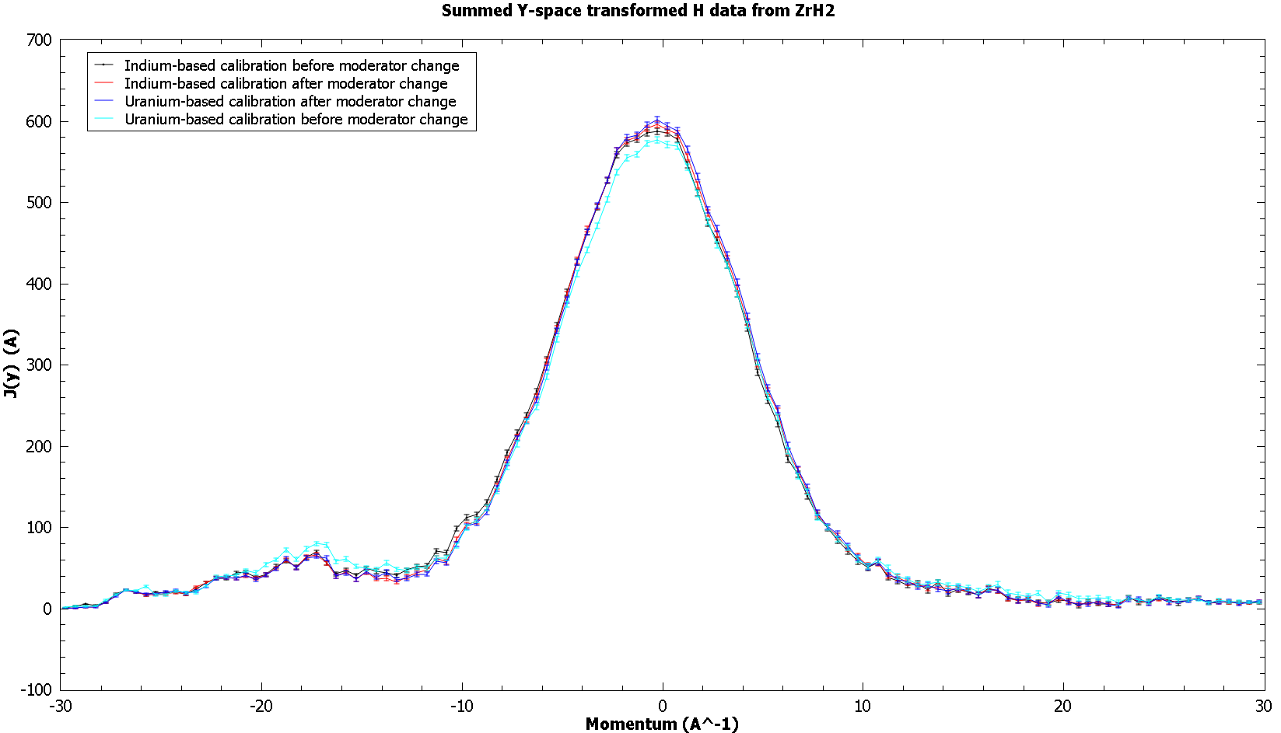
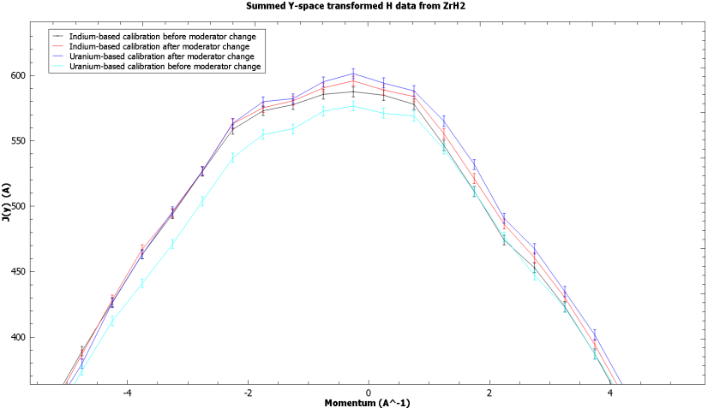
J(y) derived from pre and post moderator IP files for ZrH2 experiment before moderator change

Slide 32
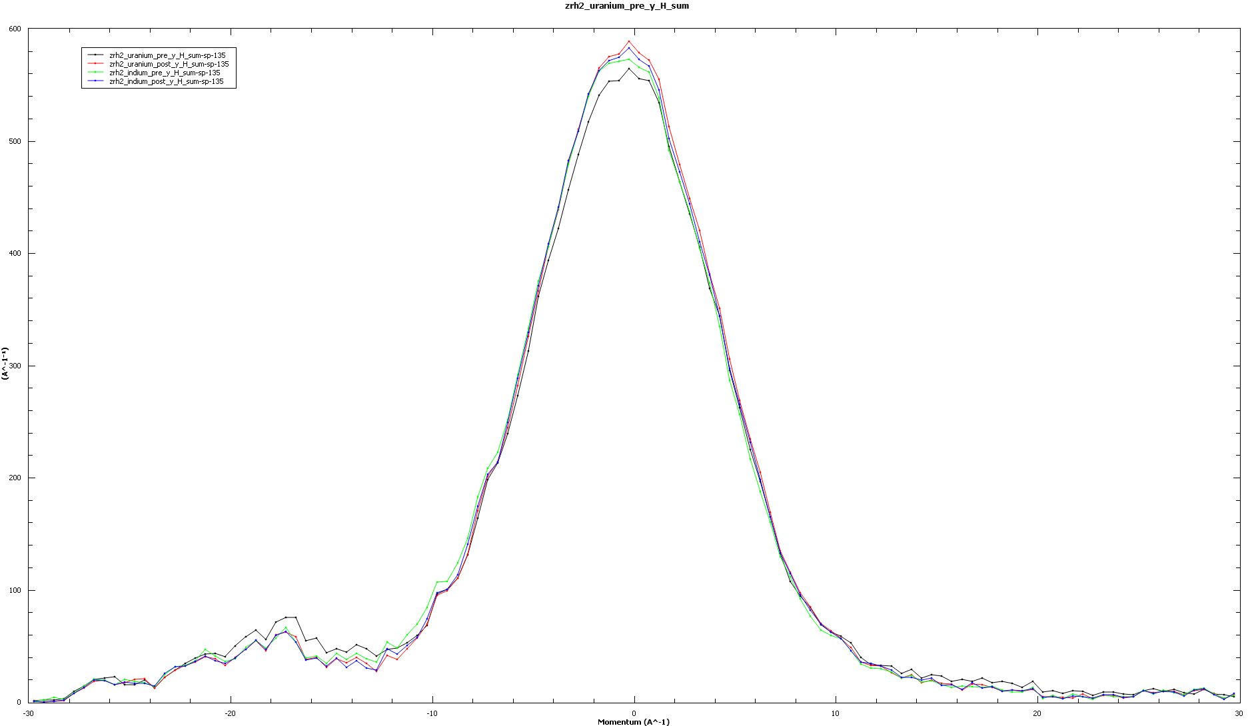
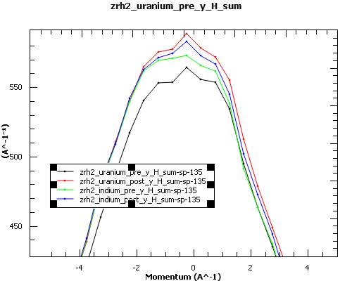
J(y) derived from pre and post moderator IP files for ZrH2 experiment after moderator change

Slide 33
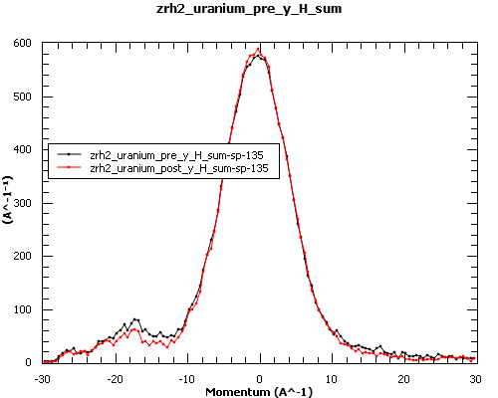
J(y) derived from pre and post moderator IP files for ZrH2 experiments before and after moderator change, respectively.
Uranium-based calibration

Slide 34
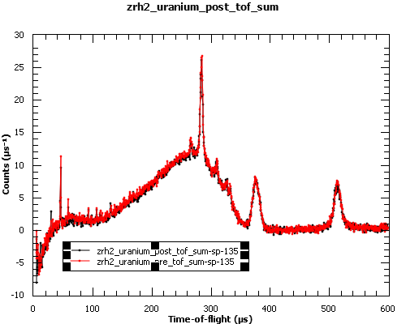
Sum of C(t) for ZrH2 experiments before and after moderator change, respectively.
Uranium-based calibration

Slide 35
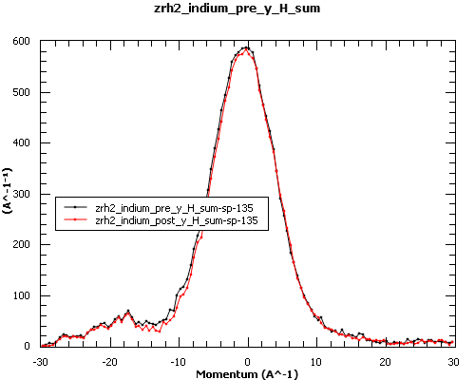
J(y) derived from pre and post moderator IP files for ZrH2 experiments before and after moderator change, respectively.
Indium-based calibration

Slide 36
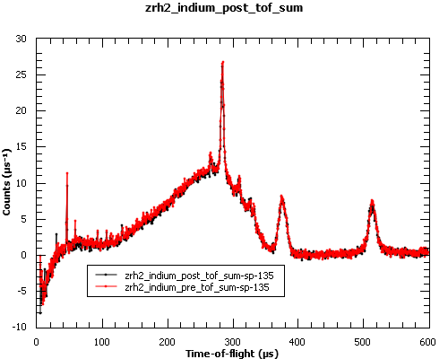
Sum of C(t) for ZrH2 experiments before and after moderator change, respectively.
Indium-based calibration

Slide 37
Conclusions:
Both in case of calibration based on uranium and indium (n, gamma) resonances, the calibration
based on using only 3 longest lead Bragg peak d-spacings yields the best results.
The discrepancies between the calibrated values before and after the moderator change are the smallest;
2. Also, in case of the calibration based on 3 longest Bragg peak d-spacings the calibration yields
values of E1 closest to 4897.3 meV which is the starting tabulated value;
3. The values of L0 and L1 are slightly shifted between indium and uranium calibration.
The L0 value from indium calibration is 11.0336 and the L0 value for uranium calibration is 11.0049.
The L1 value from indium calibration ca 3 cm smaller than L1 from uranium calibration at backscattering
and ca 1 cm smaller than L1 from uranium calibration in front scattering.
However, there is no reason why the indium-calibrated L0 and L1 values should be rejected compared to
uranium-calibrated ones.
4. The values of t0 have less spread in case of indium calibration compared to uranium-based calibration.
At backscattering they are very similar. however, at front scattering the t0 from uranium is -0.2 us
and the t0 from indium is -0.7.
5. One should try and compare both, indium and uranium-based IP files with scattering angles calculated
from fitting 3 Bragg peaks with longest d-spacings.

Slide 38
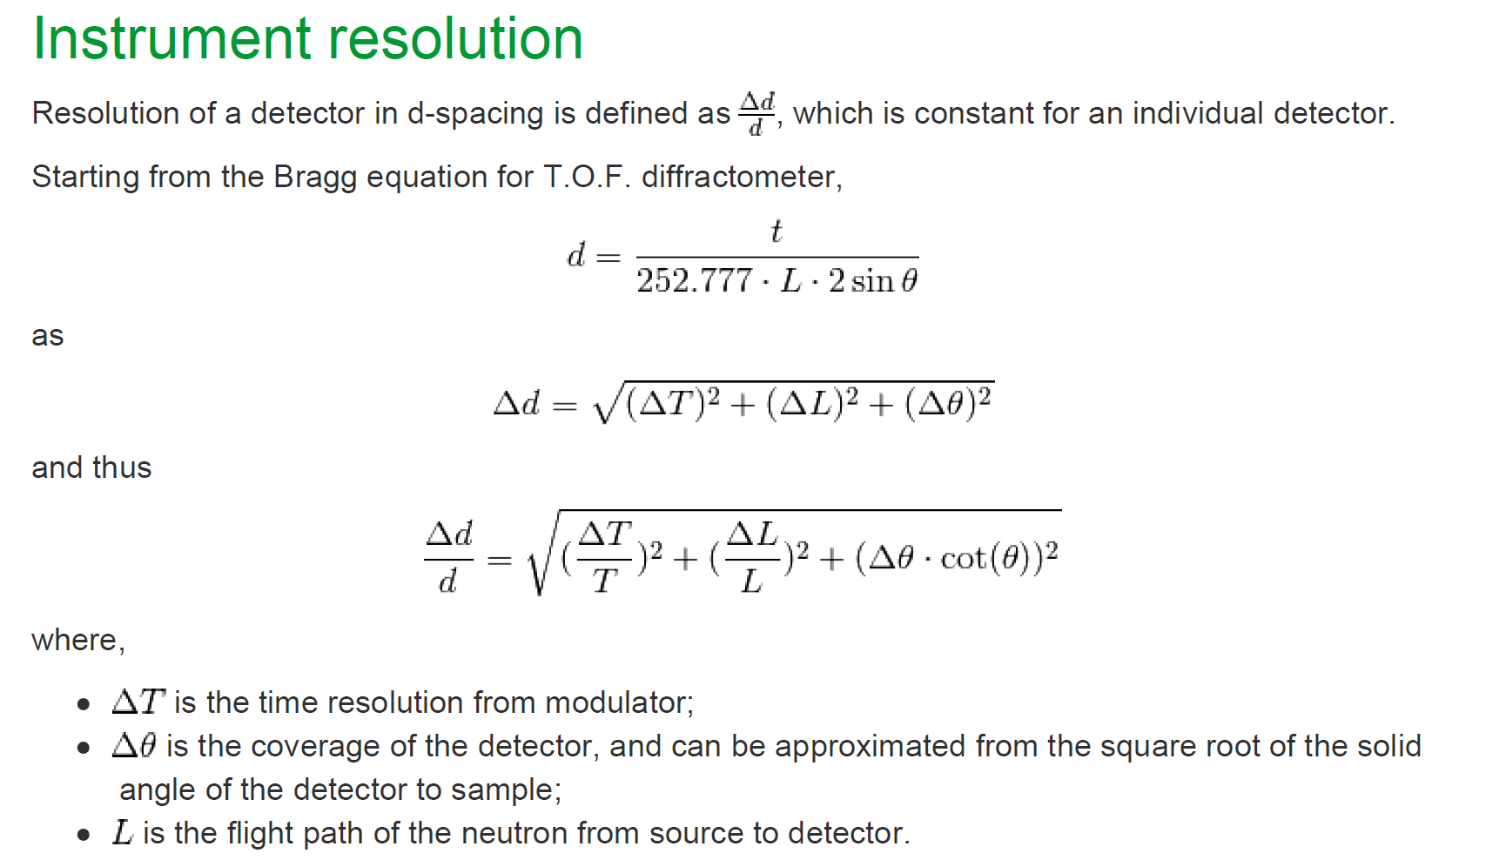
Instrument resolution calibration using different approaches to angular resolution Δϑ
moderator
, or calculated based on fitted value of $\frac{∆d}{d} in TOF$
1. assume L = L0, ΔL = ΔL0 and ΔL0 to contain both the L0 and moderator resolution (valid for epithermal );
2. assume L = L0+L1, ΔL = sqrt(ΔL0^2 + ΔL1^2) and ΔL0 to contain both the L0 and moderator resolution (valid for epithermal);
3. Assume L = L0+L1, ΔL = sqrt(ΔL0^2 + ΔL1^2) and ΔT/T = const/T = 0.43 us/T[us] where 0.43 us is the proton pulse
(better for thermal neutrons contributing to diffraction)

Slide 39
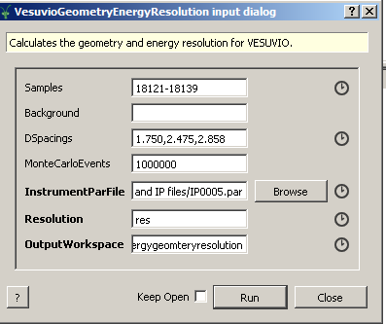
Instrument resolution calibration using different approaches to angular resolution Δϑ Calibration using lead data before moderator change

Slide 40
Resolution parameters calculated using the angular resolution function (in bold) assuming L = L0, ΔL = ΔL0 and ΔL0 to contain both the L0 and moderator resolution (valid for epithermal ); The angular resolution calculated based on Monte Carlo approach is also shown in bold.
MEAN ST DEV STD ERR WEIGHTED MEAN WEIGHTED ERROR
Front dL1 (cm) 0.501998 0.10222 0.00732014 0.501983 0.00254371
Back dTheta MC (deg) 0.946578 0.139934 0.0122261 0.947062 0.00370619
Front dTheta MC (deg) 0.789637 0.120578 0.0151914 0.79459 0.00916278
SD Back dL (cm) 2.64523 3.6924 0.322606 1.5044 0.00359756
SD Forward dL0 (cm) 2.14227 0.701669 0.088402 2.14388 0.0264619
SD Back dt0 (usec) 0.352838 0.249393 0.0217895 0.447094 0.000343458
SD Forward dt0 (usec) 0.271064 0.124867 0.0157318 0.270256 0.00234448
SD Back dL1 (cm) 7.33287 1.4235 0.2146 7.40043 0.0927143
SD Back dTheta ANA (deg) 0.428037 0.635835 0.0623488 0.428237 0.00404961
SD Forward dTheta ANA (deg) 1.24158 2.07148 0.260982 1.24794 0.0132283
SD Back Effective Width (cm) 0.427158 0.813646 0.0797846 0.427028 0.00406281
SD Forward Effective Width (cm) 1.38537 2.2257 0.280411 1.38625 0.0215982
SD Back dE1_Gauss ANA st. dev. (meV) 41.7154 18.5932 3.23666 41.5019 0.642283
SD Back dE1_Gauss MC st. dev. (meV) 41.7138 18.5944 3.23688 41.4992 0.641007
SD Back dE1_Lorentz HWHM (meV) 184.133 20.801 1.81739 183.983 0.738211
SD Forward dE1_Gauss ANA st. dev. (meV) 55.0472 17.8502 2.34385 54.978 0.460448
SD Forward dE1_Gauss MC st. dev. (meV) 55.0455 17.8516 2.34402 54.976 0.460577
SD Forward dE1_Lorentz HWHM (meV) 29.7671 18.0352 2.27222 29.5836 0.394477
DD Back dE1_Gauss ANA st. dev. (meV) 78.6935 23.3402 2.07111 78.3833 0.228593
DD Back dE1_Gauss MC st. dev. (meV) 78.6929 23.3403 2.07112 78.3826 0.228562
DD Back dE1_Lorentz HWHM (meV) 65.3678 33.4709 2.92437 64.8451 0.128911
TD Back dE1_Gauss ANA st. dev. (meV) 134.703 29.2546 2.55599 134.696 1.00815
TD Back dE1_Gauss MC st. dev. (meV) 134.703 29.2546 2.55599 134.696 1.00792
TD Back dE1_Lorentz HWHM (meV) 269.507 25.2445 2.20562 269.652 1.25733

Slide 41
Resolution parameters calculated using the angular resolution function (in bold) assuming L = L0+L1, ΔL = sqrt(ΔL0^2 + ΔL1^2) and ΔL0 to contain both the L0 and moderator resolution (valid for epithermal). The angular resolution calculated based on Monte Carlo approach is also shown in bold.
MEAN ST DEV STD ERR WEIGHTED MEAN WEIGHTED ERROR
Front dL1 (cm) 0.501998 0.10222 0.00732014 0.501983 0.00254371
Back dTheta MC (deg) 0.946578 0.139934 0.0122261 0.947062 0.00370619
Front dTheta MC (deg) 0.789637 0.120578 0.0151914 0.79459 0.00916278
SD Back dL (cm) 2.64523 3.6924 0.322606 1.5044 0.00359756
SD Forward dL0 (cm) 2.14227 0.701669 0.088402 2.14388 0.0264619
SD Back dt0 (usec) 0.352838 0.249393 0.0217895 0.447094 0.000343458
SD Forward dt0 (usec) 0.271064 0.124867 0.0157318 0.270256 0.00234448
SD Back dL1 (cm) 7.33287 1.4235 0.2146 7.40043 0.0927143
SD Back dTheta ANA (deg) 16.7669 0 1.#QNAN -1.#IND -1.#IND
SD Forward dTheta ANA (deg) 1.49911 2.56561 0.366516 1.40138 0.0131166
SD Back Effective Width (cm) 21.7868 0 1.#QNAN -1.#IND -1.#IND
SD Forward Effective Width (cm) 1.69391 2.86986 0.40998 1.62886 0.0183827
SD Back dE1_Gauss ANA st. dev. (meV) 41.7064 18.6001 3.23787 41.4868 0.63525
SD Back dE1_Gauss MC st. dev. (meV) 41.7138 18.5944 3.23688 41.4992 0.641007
SD Back dE1_Lorentz HWHM (meV) 184.133 20.801 1.81739 183.983 0.738211
SD Forward dE1_Gauss ANA st. dev. (meV) 55.0379 17.8578 2.34484 54.967 0.461171
SD Forward dE1_Gauss MC st. dev. (meV) 55.0455 17.8516 2.34402 54.976 0.460577
SD Forward dE1_Lorentz HWHM (meV) 29.7671 18.0352 2.27222 29.5836 0.394477
DD Back dE1_Gauss ANA st. dev. (meV) 78.6901 23.341 2.07118 78.3797 0.228419
DD Back dE1_Gauss MC st. dev. (meV) 78.6929 23.3403 2.07112 78.3826 0.228562
DD Back dE1_Lorentz HWHM (meV) 65.3678 33.4709 2.92437 64.8451 0.128911
TD Back dE1_Gauss ANA st. dev. (meV) 134.701 29.2547 2.55599 134.694 1.00688
TD Back dE1_Gauss MC st. dev. (meV) 134.703 29.2546 2.55599 134.696 1.00792
TD Back dE1_Lorentz HWHM (meV) 269.507 25.2445 2.20562 269.652 1.25733

Slide 42
Resolution parameters calculated using the angular resolution function (in bold) assuming L = L0+L1, ΔL = sqrt(ΔL0^2 + ΔL1^2) and ΔT/T = const/T = 0.43 us/T[us] where 0.43 us is the proton pulse (better for thermal neutrons contributing to diffraction) The angular resolution calculated based on Monte Carlo approach is also shown in bold.
MEAN ST DEV STD ERR WEIGHTED MEAN WEIGHTED ERROR
Front dL1 (cm) 0.501998 0.10222 0.00732014 0.501983 0.00254371
Back dTheta MC (deg) 0.946578 0.139934 0.0122261 0.947062 0.00370619
Front dTheta MC (deg) 0.789637 0.120578 0.0151914 0.79459 0.00916278
SD Back dL (cm) 2.64523 3.6924 0.322606 1.5044 0.00359756
SD Forward dL0 (cm) 2.14227 0.701669 0.088402 2.14388 0.0264619
SD Back dt0 (usec) 0.352838 0.249393 0.0217895 0.447094 0.000343458
SD Forward dt0 (usec) 0.271064 0.124867 0.0157318 0.270256 0.00234448
SD Back dL1 (cm) 7.33287 1.4235 0.2146 7.40043 0.0927143
SD Back dTheta ANA (deg) 16.7669 0 1.#QNAN -1.#IND -1.#IND
SD Forward dTheta ANA (deg) 1.49909 2.56562 0.366517 1.40138 0.0131186
SD Back Effective Width (cm) 21.7868 0 1.#QNAN -1.#IND -1.#IND
SD Forward Effective Width (cm) 1.69389 2.86987 0.409981 1.62886 0.0183849
SD Back dE1_Gauss ANA st. dev. (meV) 41.7064 18.6001 3.23787 41.4868 0.63525
SD Back dE1_Gauss MC st. dev. (meV) 41.7138 18.5944 3.23688 41.4992 0.641007
SD Back dE1_Lorentz HWHM (meV) 184.133 20.801 1.81739 183.983 0.738211
SD Forward dE1_Gauss ANA st. dev. (meV) 55.0379 17.8578 2.34484 54.967 0.461171
SD Forward dE1_Gauss MC st. dev. (meV) 55.0455 17.8516 2.34402 54.976 0.460577
SD Forward dE1_Lorentz HWHM (meV) 29.7671 18.0352 2.27222 29.5836 0.394477
DD Back dE1_Gauss ANA st. dev. (meV) 78.6901 23.341 2.07118 78.3797 0.228419
DD Back dE1_Gauss MC st. dev. (meV) 78.6929 23.3403 2.07112 78.3826 0.228562
DD Back dE1_Lorentz HWHM (meV) 65.3678 33.4709 2.92437 64.8451 0.128911
TD Back dE1_Gauss ANA st. dev. (meV) 134.701 29.2547 2.55599 134.694 1.00688
TD Back dE1_Gauss MC st. dev. (meV) 134.703 29.2546 2.55599 134.696 1.00792
TD Back dE1_Lorentz HWHM (meV) 269.507 25.2445 2.20562 269.652 1.25733

Slide 43
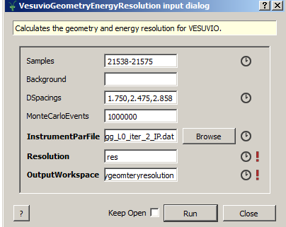
Instrument resolution calibration using different approaches to angular resolution Δϑ Calibration using lead data after moderator change

Slide 44
Resolution parameters calculated using the angular resolution function (in bold) assuming L = L0, ΔL = ΔL0 and ΔL0 to contain both the L0 and moderator resolution (valid for epithermal ); The angular resolution calculated based on Monte Carlo approach is also shown in bold.
MEAN ST DEV STD ERR WEIGHTED MEAN WEIGHTED ERROR
Front dL1 (cm) 0.495654 0.107017 0.00766365 0.496139 0.00193849
Back dTheta MC (deg) 0.972201 0.147202 0.0128611 0.971789 0.00400495
Front dTheta MC (deg) 0.802614 0.126134 0.0158914 0.810251 0.00463689
SD Back dL (cm) 2.58034 3.67396 0.320995 1.35028 0.00304619
SD Forward dL0 (cm) 2.14207 0.701914 0.0884329 2.14139 0.0283706
SD Back dt0 (usec) 0.35777 0.248615 0.0217216 0.451678 0.000366875
SD Forward dt0 (usec) 0.271035 0.125059 0.015756 0.270716 0.0039072
SD Back dL1 (cm) 7.33238 1.41729 0.216134 7.41334 0.0424677
SD Back dTheta ANA (deg) 0.384675 0.15508 0.0138708 0.38217 0.00194511
SD Forward dTheta ANA (deg) 2.03895 3.73407 0.470448 1.82115 0.0215508
SD Back Effective Width (cm) 0.363647 0.121402 0.0108585 0.363332 0.00220659
SD Forward Effective Width (cm) 2.29793 4.33846 0.546595 1.32459 0.00398498
SD Back dE1_Gauss ANA st. dev. (meV) 33.2411 17.0332 3.40663 34.0126 0.584823
SD Back dE1_Gauss MC st. dev. (meV) 33.2414 17.033 3.4066 34.0129 0.584834
SD Back dE1_Lorentz HWHM (meV) 183.213 18.5674 1.62224 183.167 1.32728
SD Forward dE1_Gauss ANA st. dev. (meV) 52.4879 11.1971 1.42203 52.5095 0.327401
SD Forward dE1_Gauss MC st. dev. (meV) 52.488 11.197 1.42202 52.5097 0.32738
SD Forward dE1_Lorentz HWHM (meV) 30.6502 27.7725 3.49901 30.6404 0.220209
DD Back dE1_Gauss ANA st. dev. (meV) 75.4033 21.7936 1.90411 75.5382 0.33762
DD Back dE1_Gauss MC st. dev. (meV) 75.4034 21.7935 1.90411 75.5383 0.337611
DD Back dE1_Lorentz HWHM (meV) 63.8162 28.3186 2.47421 63.8392 0.411312
TD Back dE1_Gauss ANA st. dev. (meV) 129.371 23.2514 2.03148 129.404 0.919954
TD Back dE1_Gauss MC st. dev. (meV) 129.371 23.2514 2.03148 129.404 0.919888
TD Back dE1_Lorentz HWHM (meV) 272.982 25.5918 2.23597 272.927 0.744849

Slide 45
Resolution parameters calculated using the angular resolution function (in bold) assuming L = L0+L1, ΔL = sqrt(ΔL0^2 + ΔL1^2) and ΔL0 to contain both the L0 and moderator resolution (valid for epithermal). The angular resolution calculated based on Monte Carlo approach is also shown in bold.
MEAN ST DEV STD ERR WEIGHTED MEAN WEIGHTED ERROR
Front dL1 (cm) 0.495654 0.107017 0.00766365 0.496139 0.00193849
Back dTheta MC (deg) 0.972201 0.147202 0.0128611 0.971789 0.00400495
Front dTheta MC (deg) 0.802614 0.126134 0.0158914 0.810251 0.00463689
SD Back dL (cm) 2.58034 3.67396 0.320995 1.35028 0.00304619
SD Forward dL0 (cm) 2.14207 0.701914 0.0884329 2.14139 0.0283706
SD Back dt0 (usec) 0.35777 0.248615 0.0217216 0.451678 0.000366875
SD Forward dt0 (usec) 0.271035 0.125059 0.015756 0.270716 0.0039072
SD Back dL1 (cm) 7.33238 1.41729 0.216134 7.41334 0.0424677
SD Back dTheta ANA (deg) -1.#IND 1.#QNAN 1.#QNAN 1.#QNAN 1.#QNAN
SD Forward dTheta ANA (deg) 2.11531 4.02394 0.515213 2.00727 0.0309174
SD Back Effective Width (cm) -1.#IND 1.#QNAN 1.#QNAN 1.#QNAN 1.#QNAN
SD Forward Effective Width (cm) 2.40831 4.73341 0.606051 1.23031 0.00334897
SD Back dE1_Gauss ANA st. dev. (meV) 33.2221 17.0444 3.40888 33.9937 0.583987
SD Back dE1_Gauss MC st. dev. (meV) 33.2414 17.033 3.4066 34.0129 0.584834
SD Back dE1_Lorentz HWHM (meV) 183.213 18.5674 1.62224 183.167 1.32728
SD Forward dE1_Gauss ANA st. dev. (meV) 52.4744 11.2008 1.4225 52.4977 0.328925
SD Forward dE1_Gauss MC st. dev. (meV) 52.488 11.197 1.42202 52.5097 0.32738
SD Forward dE1_Lorentz HWHM (meV) 30.6502 27.7725 3.49901 30.6404 0.220209
DD Back dE1_Gauss ANA st. dev. (meV) 75.3973 21.795 1.90424 75.5312 0.338361
DD Back dE1_Gauss MC st. dev. (meV) 75.4034 21.7935 1.90411 75.5383 0.337611
DD Back dE1_Lorentz HWHM (meV) 63.8162 28.3186 2.47421 63.8392 0.411312
TD Back dE1_Gauss ANA st. dev. (meV) 129.367 23.2513 2.03147 129.4 0.9246
TD Back dE1_Gauss MC st. dev. (meV) 129.371 23.2514 2.03148 129.404 0.919888
TD Back dE1_Lorentz HWHM (meV) 272.982 25.5918 2.23597 272.927 0.744849

Slide 46
Resolution parameters calculated using the angular resolution function (in bold) assuming L = L0+L1, ΔL = sqrt(ΔL0^2 + ΔL1^2) and ΔT/T = const/T = 0.43 us/T[us] where 0.43 us is the proton pulse (better for thermal neutrons contributing to diffraction) The angular resolution calculated based on Monte Carlo approach is also shown in bold.
MEAN ST DEV STD ERR WEIGHTED MEAN WEIGHTED ERROR
Front dL1 (cm) 0.495654 0.107017 0.00766365 0.496139 0.00193849
Back dTheta MC (deg) 0.972201 0.147202 0.0128611 0.971789 0.00400495
Front dTheta MC (deg) 0.802614 0.126134 0.0158914 0.810251 0.00463689
SD Back dL (cm) 2.58034 3.67396 0.320995 1.35028 0.00304619
SD Forward dL0 (cm) 2.14207 0.701914 0.0884329 2.14139 0.0283706
SD Back dt0 (usec) 0.35777 0.248615 0.0217216 0.451678 0.000366875
SD Forward dt0 (usec) 0.271035 0.125059 0.015756 0.270716 0.0039072
SD Back dL1 (cm) 7.33238 1.41729 0.216134 7.41334 0.0424677
SD Back dTheta ANA (deg) -1.#IND 1.#QNAN 1.#QNAN 1.#QNAN 1.#QNAN
SD Forward dTheta ANA (deg) 2.1153 4.02395 0.515214 2.00728 0.0309181
SD Back Effective Width (cm) -1.#IND 1.#QNAN 1.#QNAN 1.#QNAN 1.#QNAN
SD Forward Effective Width (cm) 2.40829 4.73341 0.606051 1.2303 0.00334901
SD Back dE1_Gauss ANA st. dev. (meV) 33.2221 17.0444 3.40888 33.9937 0.583987
SD Back dE1_Gauss MC st. dev. (meV) 33.2414 17.033 3.4066 34.0129 0.584834
SD Back dE1_Lorentz HWHM (meV) 183.213 18.5674 1.62224 183.167 1.32728
SD Forward dE1_Gauss ANA st. dev. (meV) 52.4744 11.2008 1.4225 52.4977 0.328925
SD Forward dE1_Gauss MC st. dev. (meV) 52.488 11.197 1.42202 52.5097 0.32738
SD Forward dE1_Lorentz HWHM (meV) 30.6502 27.7725 3.49901 30.6404 0.220209
DD Back dE1_Gauss ANA st. dev. (meV) 75.3973 21.795 1.90424 75.5312 0.338361
DD Back dE1_Gauss MC st. dev. (meV) 75.4034 21.7935 1.90411 75.5383 0.337611
DD Back dE1_Lorentz HWHM (meV) 63.8162 28.3186 2.47421 63.8392 0.411312
TD Back dE1_Gauss ANA st. dev. (meV) 129.367 23.2513 2.03147 129.4 0.9246
TD Back dE1_Gauss MC st. dev. (meV) 129.371 23.2514 2.03148 129.404 0.919888
TD Back dE1_Lorentz HWHM (meV) 272.982 25.5918 2.23597 272.927 0.744849

Slide 47
Conclusions:
Still persisting discrepancies between the Monte Carlo-based and diffraction-based calculation
of the angular resolution function for all 3 models of the angular resolution function discussed;
Probably one needs a McStas-based model for the dT/T component of the Bragg peak widths
accounting for energy (and thus TOF T) dependent dT/T on Vesuvio in the thermal region.
Also, the value of dL0 assumed for Bragg peaks needs to be smaller. At present, dL0 is accounting for
both geometrical uncertainty and time resolution for epithermal energies that are not contributing at all
to the Bragg peaks.
Discrepancies between front and backscattering values od dL1 compared to published 2.1 cm;
Values of dt0 in good agreement with published values;
Values of dL0 in good agreement with published values;
Values of energy resolution in good agreement with published values;

